Slide 2

SCHWARZ INTEGRAL FORMULA
Let f be an analytic function of z throughout the half plane Im_{z} ≥ 0 such that for some positive constants a and M, the order property
(1)
is satisfied.

Slide 3
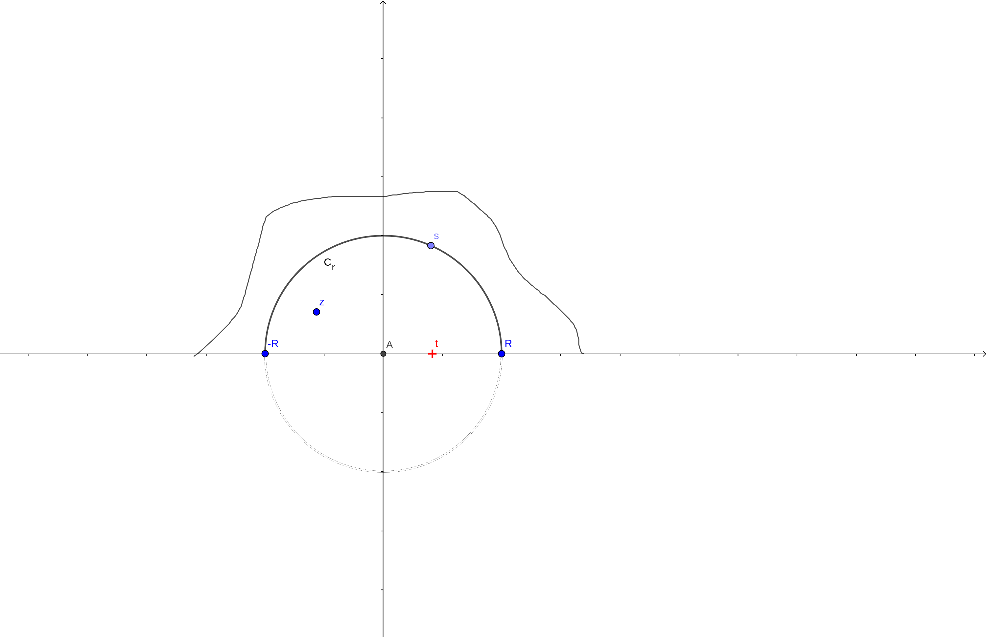
SCHWARZ INTEGRAL FORMULA
For a fixed point z above the real axis, let C_{R} denote the upper half of a positively oriented circle of radius R centred at the origin, where R > |z|.
Then, according to the Cauchy Integral Formula:
(2)

Slide 4
SCHWARZ INTEGRAL FORMULA
We find that the first of these integrals approaches 0 as R tends to ∞ since, in view of condition (1)
Thus
(3)
Ensures that the improper integral here converges to it’s Cauchy Principal Value. The above formula is the Cauchy Integral Formula for the half plane

Slide 5
SCHWARZ INTEGRAL FORMULA
When the point z lies below the real axis, the right hand side of the equation (2) is zero as it lies outside the contour ; Hence integral (3) is zero for such a point. Thus when c is above the real axis, we have the following formula, where c is an arbitrary complex constant.
(4)

Slide 6
SCHWARZ INTEGRAL FORMULA
In the two cases when c = 1 and c = -1, this reduces respectively to
(5)
and
(6)

Slide 7
SCHWARZ INTEGRAL FORMULA
If f(z) = u(x,y) + iv(x,y), it follows from formulas (5) and (6) that the harmonic functions u and v are represented in the half plane y > 0 in terms of the boundary values of u by the formulas:
(7)
(y>0)
and
(8)
(y>0)
Formula (7) is the Schwarz Integral formula or the Poisson Integral formula for the half plane.

